Slide 1
Algorithm Analysis and Design Linear Time Sorting (Shell Sort)
Lecture -23

Slide 2
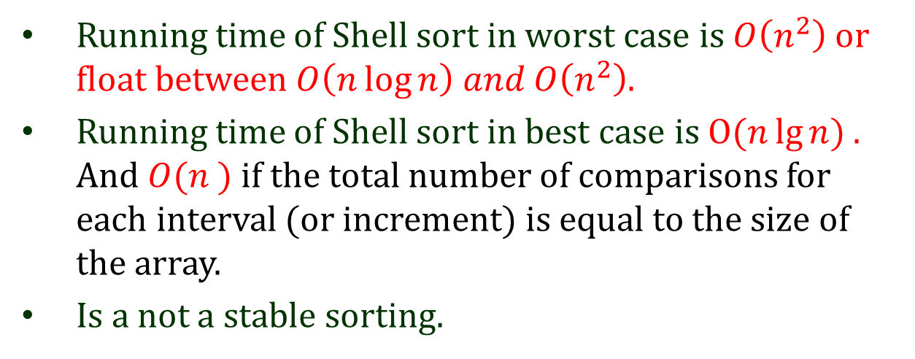
Overview
Running time of Shell sort in worst case is $O\left(n^{2}\right)$ or float between$O\left(n\log{n}\right) and O\left(n^{2}\right)$.
Running time of Shell sort in best case is $Ο(n\lg{n})$ . And $O(n )$ if the total number of comparisons for each interval (or increment) is equal to the size of the array.
Is a not a stable sorting.

Slide 3
Shell Sort
Designed by Donald Shell and named the sorting algorithm after himself in 1959.
Shell sort works by comparing elements that are distant rather than adjacent elements in an array or list where adjacent elements are compared.
Shell sort is also known as diminishing increment sort.

Slide 4
Shell Sort
Shell sort improves on the efficiency of insertion sort by quickly shifting values to their destination.
This algorithm tries to decreases the distance between comparisons (i.e. gap) as the sorting algorithm runs and reach to its last phase where, the adjacent elements are compared only.

Slide 5
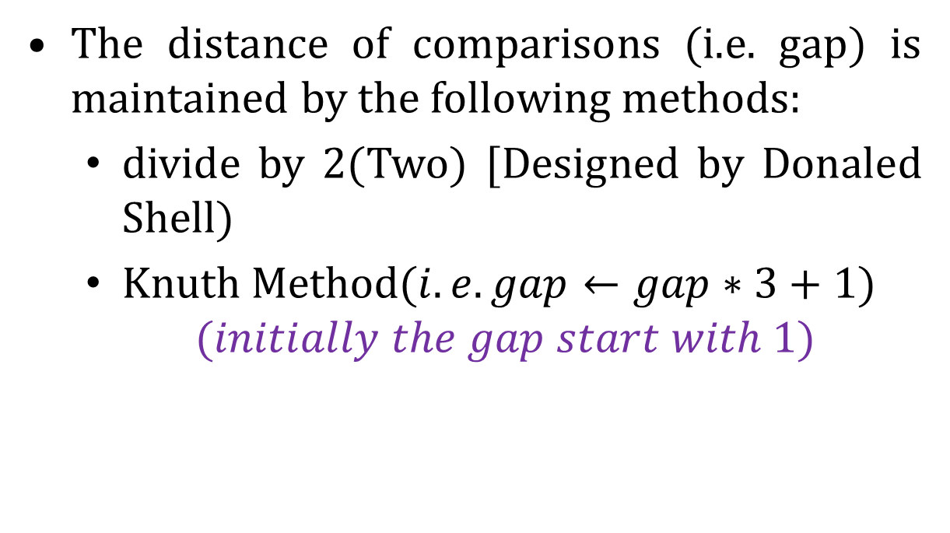
Shell Sort
The distance of comparisons (i.e. gap) is maintained by the following methods:
divide by 2(Two) [Designed by Donaled Shell)
Knuth Method$(i.e. gap←gap∗3+1)$
$$(initially the gap start with 1)$$

Slide 6
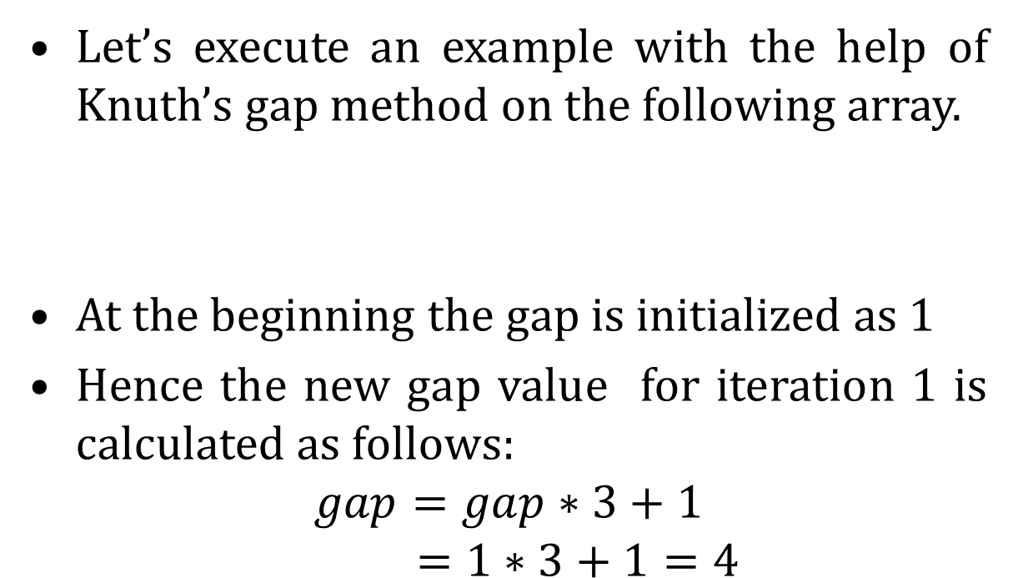
Shell Sort
Let’s execute an example with the help of Knuth’s gap method on the following array.
At the beginning the gap is initialized as 1
Hence the new gap value for iteration 1 is calculated as follows:
$$gap=gap∗3+1$$
$$=1∗3+1=4$$
35
33
42
10
14
19
27
44

Slide 7
Shell Sort
Swap count =0
35
33
42
10
14
19
27
44
swap

Slide 8
Shell Sort
Swap count =1
14
33
42
10
35
19
27
44
Swap

Slide 9
Shell Sort
Swap count =1
14
33
42
10
35
19
27
44
swap

Slide 10
Shell Sort
Swap count =2
14
19
42
10
35
33
27
44
swap

Slide 11
Shell Sort
Swap count =2
14
19
42
10
35
33
27
44
swap

Slide 12
Shell Sort
Swap count =3
14
19
27
10
35
33
42
44
swap

Slide 13
Shell Sort
Swap count =3
14
19
27
10
35
33
42
44
No swap required

Slide 14
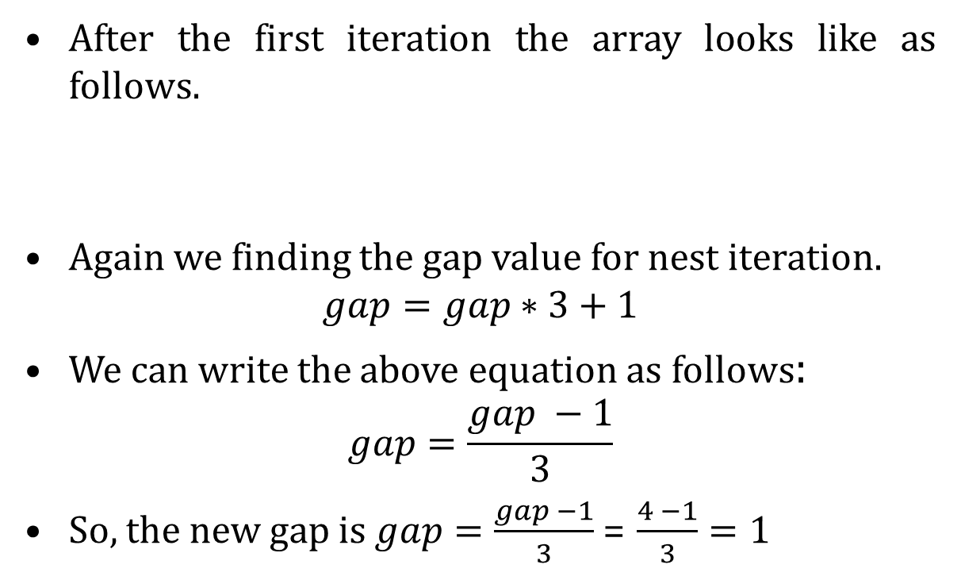
Shell Sort
After the first iteration the array looks like as follows.
Again we finding the gap value for nest iteration.
$$gap=gap∗3+1$$
We can write the above equation as follows:
$$gap=\frac{gap −1}{3}$$
So, the new gap is $gap=\frac{gap −1}{3}$ = $\frac{4 −1}{3}=1$
14
19
27
10
35
33
42
44

Slide 15
Shell Sort
Swap count =3
14
19
27
10
35
33
42
44
No swap

Slide 16
Shell Sort
Swap count =3
14
19
27
10
35
33
42
44
No swap

Slide 17
Shell Sort
Swap count =3
14
19
27
10
35
33
42
44
swap

Slide 18
Shell Sort
Swap count =4
14
19
10
27
35
33
42
44
swap

Slide 19
Shell Sort
Swap count =4
14
19
10
27
35
33
42
44
swap
14
19
10
27
35
33
42
44
swap

Slide 20
Shell Sort
Swap count =5
14
19
10
27
35
33
42
44
swap
14
10
19
27
35
33
42
44
swap

Slide 21
Shell Sort
Swap count =5
14
19
10
27
35
33
42
44
swap
14
10
19
27
35
33
42
44
swap
14
10
19
27
35
33
42
44
swap

Slide 22
Shell Sort
Swap count =6
14
19
10
27
35
33
42
44
swap
14
10
19
27
35
33
42
44
swap
10
14
19
27
35
33
42
44
swap

Slide 23
Shell Sort
Swap count =6
10
14
19
27
35
33
42
44
No swap

Slide 24
Shell Sort
Swap count =6
10
14
19
27
35
33
42
44
swap

Slide 25
Shell Sort
Swap count =7
10
14
19
27
33
35
42
44
swap

Slide 26
Shell Sort
Swap count =7
10
14
19
27
33
35
42
44
No swap

Slide 27
Shell Sort
Swap count =7
10
14
19
27
33
35
42
44
No swap

Slide 28
Shell Sort
Swap count =7
Hence ,total number of swap required in
1st iteration= 3
2nd iteration= 4
So total 7 numbers of swap required to sort the array by shell sort.
10
14
19
27
33
35
42
44
No swap

Slide 29
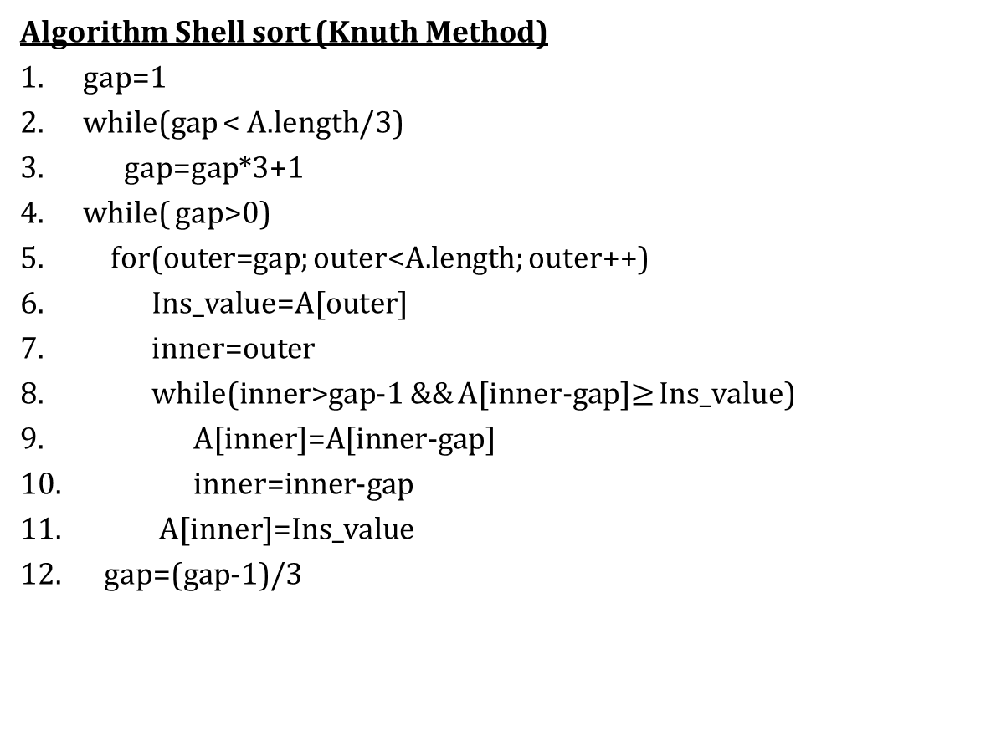
Shell Sort
Algorithm Shell sort (Knuth Method)
gap=1
while(gap < A.length/3)
gap=gap*3+1
while( gap>0)
for(outer=gap; outer<A.length; outer++)
Ins_value=A[outer]
inner=outer
while(inner>gap-1 && A[inner-gap]$≥$ Ins_value)
A[inner]=A[inner-gap]
inner=inner-gap
A[inner]=Ins_value
gap=(gap-1)/3

Slide 30
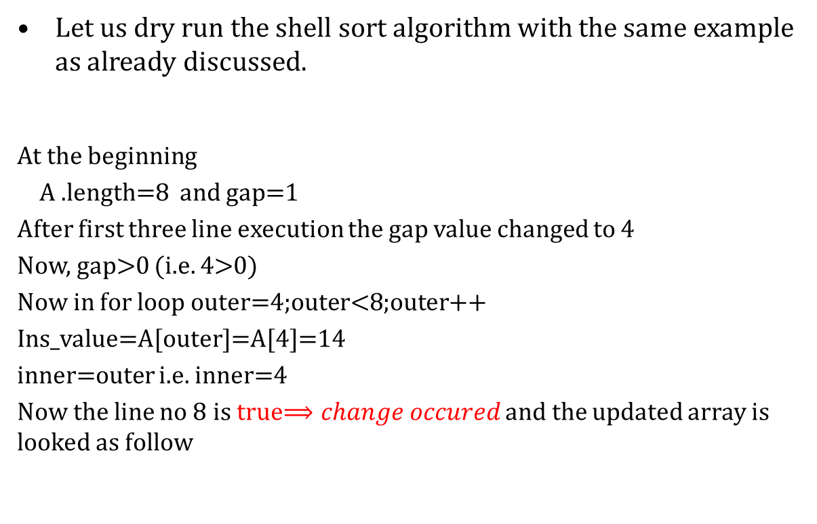
Shell Sort
Let us dry run the shell sort algorithm with the same example as already discussed.
At the beginning
A .length=8 and gap=1
After first three line execution the gap value changed to 4
Now, gap>0 (i.e. 4>0)
Now in for loop outer=4;outer<8;outer++
Ins_value=A[outer]=A[4]=14
inner=outer i.e. inner=4
Now the line no 8 is true$⟹change occured$ and the updated array is looked as follow
35
33
42
10
14
19
27
44
14
33
42
10
35
19
27
44
Swap

Slide 31

Shell Sort
Now in for loop outer=5 ;outer<8; outer++
Ins_value=A[outer]=A[5]=19
inner=outer i.e. inner=5
Now the line no 8 is true$⟹change occured$ and the updated array is looked as follow
14
19
42
10
35
33
27
44
swap

Slide 32

Shell Sort
Now in for loop outer=6 ;outer<8; outer++
Ins_value=A[outer]=A[6]=27
inner=outer i.e. inner=6
Now the line no 8 is true$⟹change occured$ and the updated array is looked as follow
14
19
27
10
35
33
42
44
swap

Slide 33

Shell Sort
Now in for loop outer=7 ;outer<8; outer++
Ins_value=A[outer]=A[7]=44
inner=outer i.e. inner=7
Now the line no 8 is False $⟹$ no change in array and the updated array is looked as follow
14
19
27
10
35
33
42
44
No swap required

Slide 34
Shell Sort
Now again gap value will be calculated .
The new gap value is 1. And again the same procedure will be continued .

Slide 36
Shell Sort
Now again gap value will be calculated .
The new gap value is 1. And again the same procedure will be continued .
Home Assignment

Slide 37
Shell Sort
Now again gap value will be calculated .
The new gap value is 1. And again the same procedure will be continued . And finally the sorted array looks as given below with 7(seven) number of swap
10
14
19
27
33
35
42
44

Slide 38
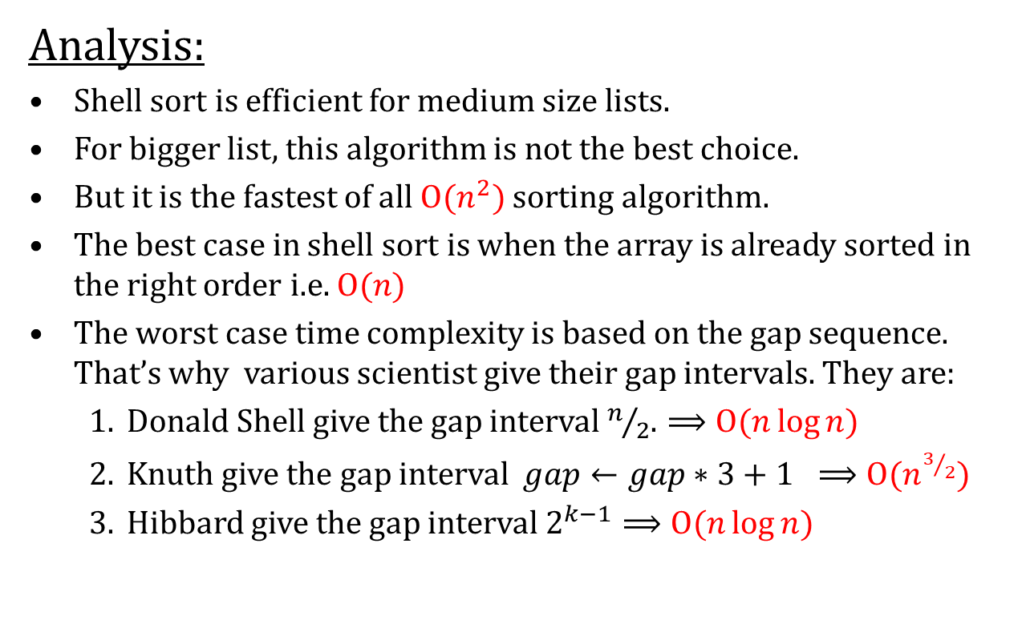
Shell Sort
Analysis:
Shell sort is efficient for medium size lists.
For bigger list, this algorithm is not the best choice.
But it is the fastest of all $Ο(n^{2})$ sorting algorithm.
The best case in shell sort is when the array is already sorted in the right order i.e. $Ο(n)$
The worst case time complexity is based on the gap sequence. That’s why various scientist give their gap intervals. They are:
Donald Shell give the gap interval $n/2$. $⟹Ο(n\log{n}$)
Knuth give the gap interval $gap←gap∗3+1 ⟹Ο(n^{3/2}$)
Hibbard give the gap interval $2^{k−1}⟹Ο(n\log{n}$)

Slide 39
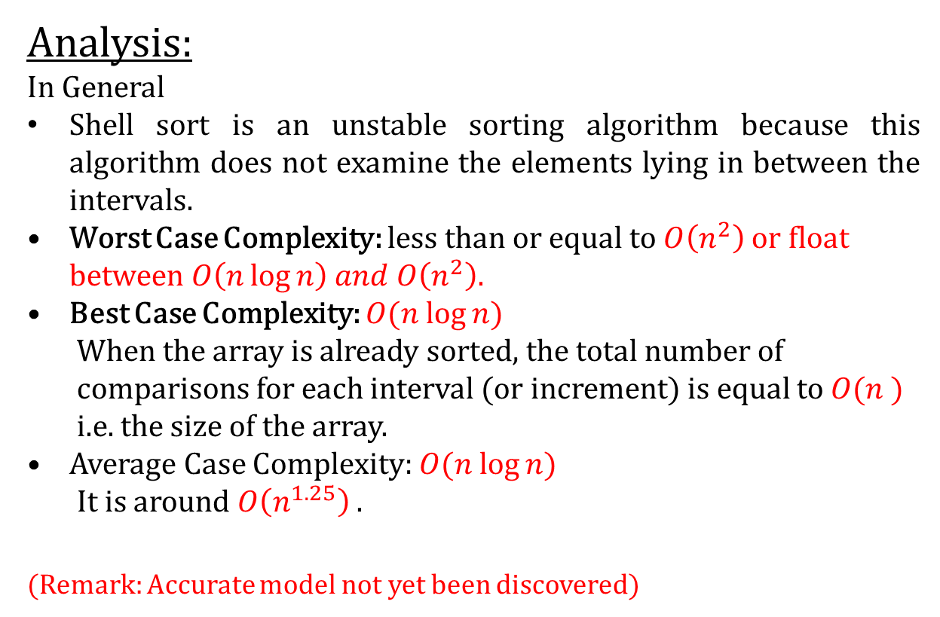
Shell Sort
Analysis:
In General
Shell sort is an unstable sorting algorithm because this algorithm does not examine the elements lying in between the intervals.
Worst Case Complexity: less than or equal to $O\left(n^{2}\right)$ or float between $O\left(n\log{n}\right) and O\left(n^{2}\right)$.
Best Case Complexity: $O(n log⁡n)$
When the array is already sorted, the total number of comparisons for each interval (or increment) is equal to $O(n )$ i.e. the size of the array.
Average Case Complexity: $O(n log⁡n)$
It is around $O\left(n^{1.25}\right)$ .
(Remark: Accurate model not yet been discovered)

Slide 40
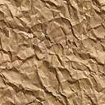
Thank U

